Slide 1

Introduction to Deep Learning
Rohit Padebettu
Notes:
The superstar of machine learning
Many slides come from Deep Learning, A visual introduction slides.
https://www.slideshare.net/LuMa921/deep-learning-a-visual-introduction

Slide 2
Course Assignments
Programming Assignments
Reading Assignments
Presentation Assignments
Technical Skills Assignments
Writing Assignments

Slide 3
Technical Assignment
Complete & Submit Code on GitHub for Mushroom Classification

Slide 4
Programming Assignment
Install & Complete: Swirl – Regression Models
Install & Complete: Swirl – Getting & Cleaning Data

Slide 5
Reading Assignment
Read Chapter 4: Classification
Read Chapter 8: Tree Based Methods

Slide 6
Writing Assignment
No Writing Assignment this week !!!

Slide 7
Presentation Assignment
By Saturday Submit
Your Presentations on Mushroom Classification Case
Technical Presentation
Business Presentation (Not to exceed 5 slides)

Slide 8
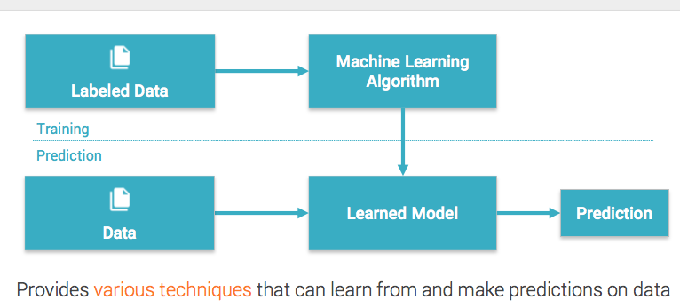
Machine Learning
Notes:
Three types:

Slide 9
Where we are
Data Science
Machine Learning
Deep
Learning
Deep Neural Networks

Slide 10
Why Neural Networks ?
Linear Discriminant Analysis

Slide 11
How to Classify this?
Line can’t be used to classify this.
This is a so-called nonlinear classification problem.

Slide 12
And this?

Slide 13
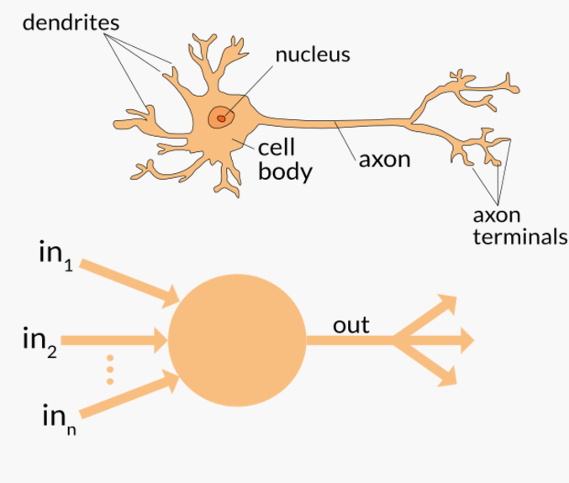
Neural Networks - Inspiration
Inspired by brain neural networks

Slide 14
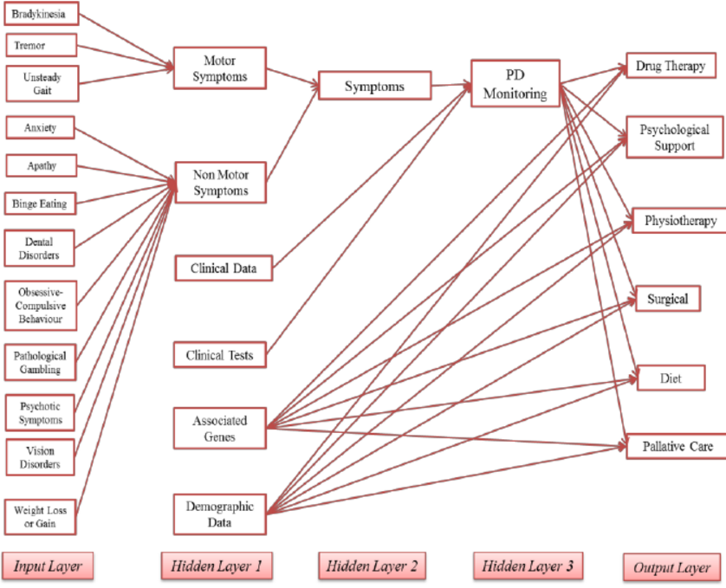

Applications
Image and speech recognition
Precision medicine

Slide 15


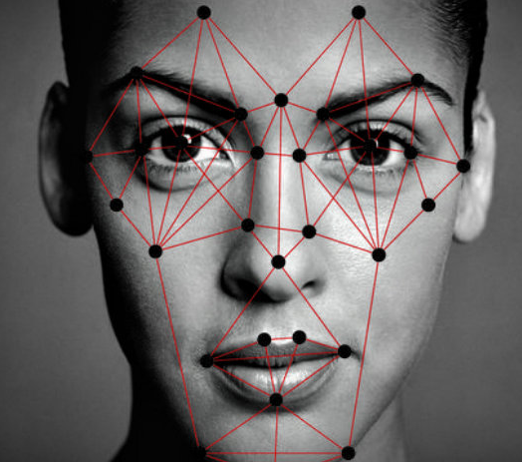
Applications
Playing games
Predicting court decisions
Translating languages

Slide 16
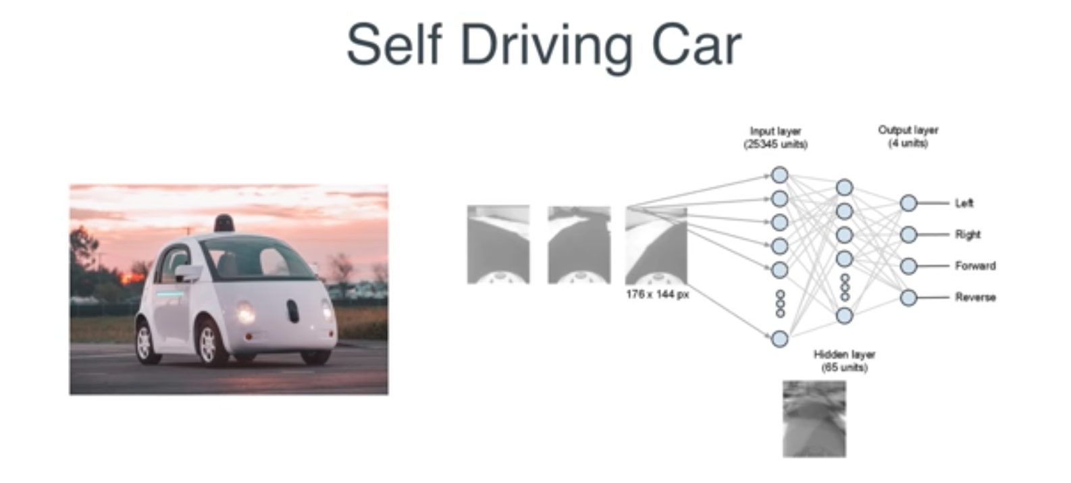

Applications

Slide 17
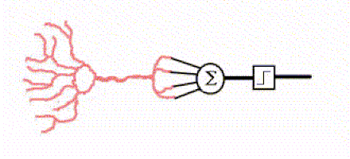
Neural Networks – How?

Slide 18
Neural Networks – How?
Input 1 (x1) = 0.6 Input 2 (x2) = 1.0
Weight 1 (w1) = 50% Weight 2 (w2) = 80%
Sum
x1*w1 + x2*w2 = (0.6 x 0.5) + (1 x 0.8) = 1.1
Activation
Is Sum >= (Threshold = 1.0) ?
Activation
Is Sum >= (Threshold = 1.0) ?
Neuron Fires
Notes:
Adding more layers to MLP does not works (e.g., to compete with SVM) due to "diminishing error problem" (i.e., the error from the output layer that was back propagated to the inner layer getting small and small, hence in short the MLP infact does not learn"; (2) Three layers MLP was mathematically explained to be a unversal approximator -- in short there was no reason to add more layers;
What is the difference between the classical artificial neural network and the new deep learning generation?. Available from: https://www.researchgate.net/post/What_is_the_difference_between_the_classical_artificial_neural_network_and_the_new_deep_learning_generation [accessed Jun 2, 2017].
Neuron pictures from https://appliedgo.net/perceptron/
The transistors in a computer are wired in relatively simple, serial chains (each one is connected to maybe two or three others in basic arrangements known as logic gates), whereas the neurons in a brain are densely interconnected in complex, parallel ways (each one is connected to perhaps 10,000 of its neighbors).

Slide 19
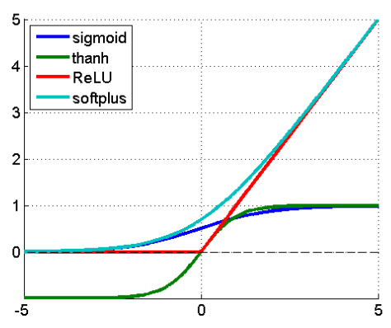
Activation Functions
Activation or transfer function
Nonlinear Outputs

Slide 20
A Single Neuron
With two inputs, a neuron can classify the data points in two-dimensional space into two kinds with a straight line.
If you have three inputs, a neuron can classify data points in three-dimensional space into two parts with a flat plane, and so on. This is called "dividing n-dimensional space with a hyperplane."

Slide 21
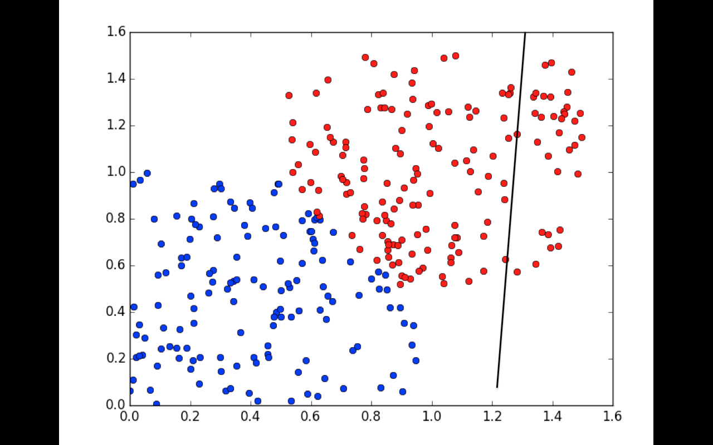

Slide 22
Deep Learning
Break Time

Slide 23
Classic Neural Networks
Exceptional at recognizing patterns
Impractical to have more than 1 hidden layer
Features must be given in usable form
Only work for supervised ML

Slide 24
What is Feature Engineering?
Manually choosing input features or Deriving New Features
Pros
Reduce complexity and computation
Prevent over-fitting due to redundant features
Prevent curse of dimensionality for small datasets
Cons
Costly
Requires domain knowledge
Difficult

Slide 25
Deep Learning
Set of techniques for learning in neural networks
The study of neural networks
Can be supervised or unsupervised

Slide 26
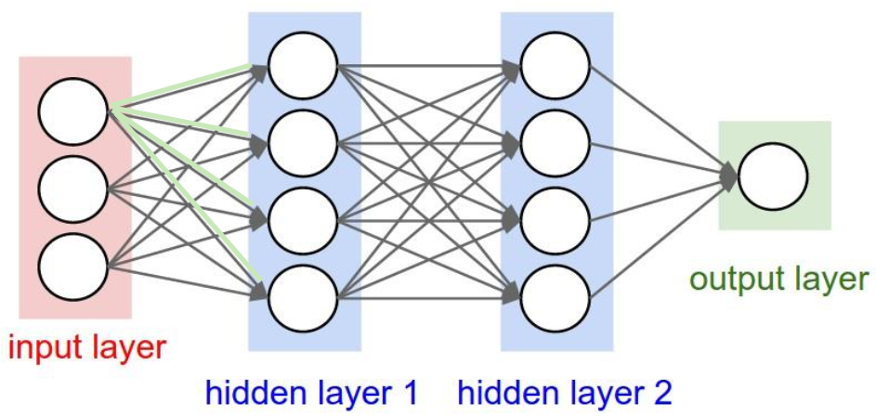
Neurons organized in layers

Slide 27
Multi Layer Perceptron (MLP)
Notes:
What's happening here? If you click each one of the neurons in the hidden layer, you see they're each doing a simple, single-line classification:
The first neuron checks if a data point is on the left or right
The second neuron checks if it's in the top right
The third one checks if it's in the bottom right
These three results are called features of the data. Outputs from these neurons indicate the strength of their corresponding features.
Finally, the neuron on the output layer uses these features to classify the data. If you draw a three dimensional space consisting of the feature values, the final neuron can simply divide this space with a flat plane. This is an example of a transformation of the original data into a feature space.
fully-connected hidden layers in- between. Each layer is represented as a series of neurons and progressively extracts higher and higher-level features of the input until the final layer essentially makes a decision about what the input shows. The more layers the network has, the higher- level features it will learn.

Slide 28
Deep Neural Networks
Algorithms that have one or more hidden layers
Exceptional at learning patterns
Non-”deep” neural networks can only be supervised. Example: Support Vector Machines

Slide 29
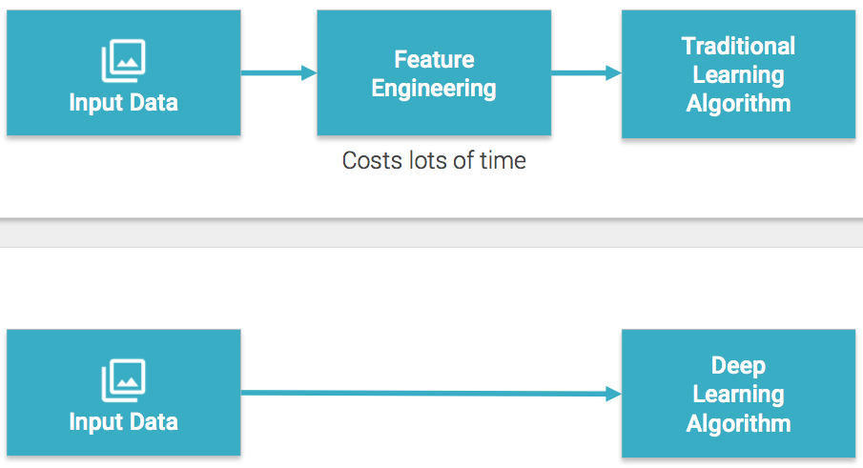
Feature engineering not needed

Slide 30
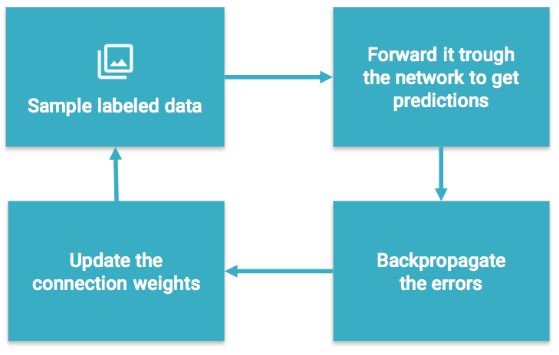
Training a Neural Network
Notes:
Learns by generating an error signal that measures the difference between the predictions of the network and the desired values and then using this error signal to change the weights (or parameters) so that predictions get more accurate.

Slide 31
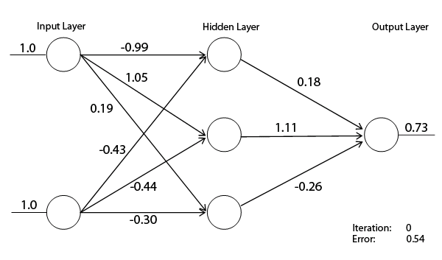
Neural Network - Learning

Slide 32
Deep Neural Networks
Train on new data
After a wrong classification, they can recalculate the importance of a feature
Example: Leaf Dataset
Notes:
Where the “deep” part comes in, is that the system, as time goes on and it gains more experience, can increase its probability of a correct classification, by “training” itself on the new data it receives. In other words it can learn from its mistakes -just like us. For example it may incorrectly decide that a particular vehicle was a certain make and model, based on their similar size and engine noise, overlooking another differentiator which it determined had a low probability of being important to the decision. By learning that this differentiator is, in fact, vital to understanding the difference between two vehicles, it improves the probability of a correct outcome next time.

Slide 33
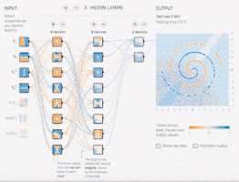
Deep Neural Network

Slide 34
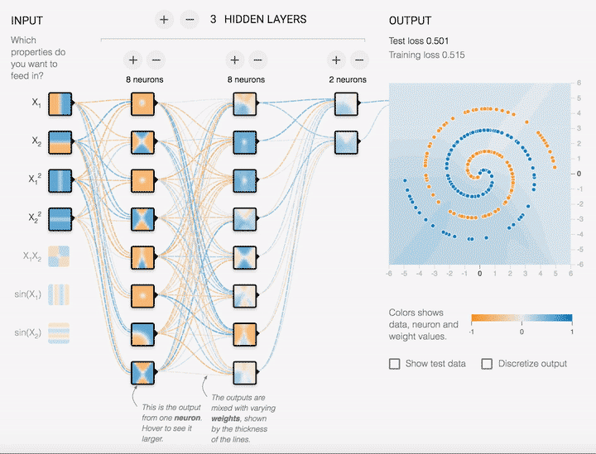

Slide 35
Strengths of Deep Neural Networks
Classifying based on combinations of features or units
Things that human brains do automatically

Slide 36
Image Recognition

Slide 37

Image Recognition

Slide 38
ImageNet Challenge (1000 Classes)
How often the model fails to predict the correct answer as one of their top 5 guesses -- termed "top-5 error rate".
How well do humans do on ImageNet Challenge?
There's a blog post by Andrej Karpathy.
He reached 5.1% top-5 error rate.

Slide 39
ImageNet Challenge
AlexNet achieved by setting a top-5 error rate of 15.3% on the 2012 validation data set
Inception (GoogLeNet) achieved 6.67%
BN-Inception-v2 achieved 4.9%
Inception-v3 reaches 3.46%
Inception V3 – by Google

Slide 40
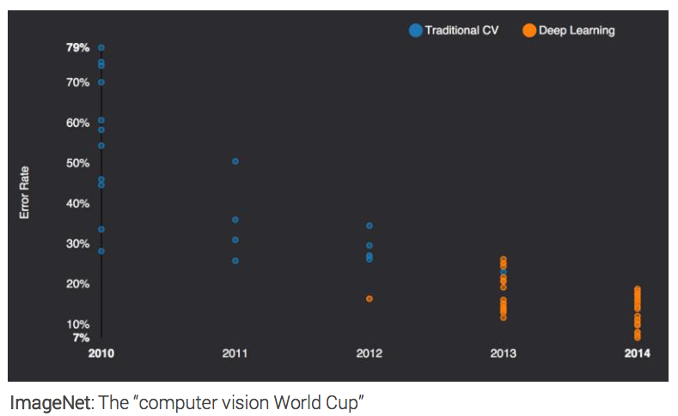
Blowing away the competition

Slide 41
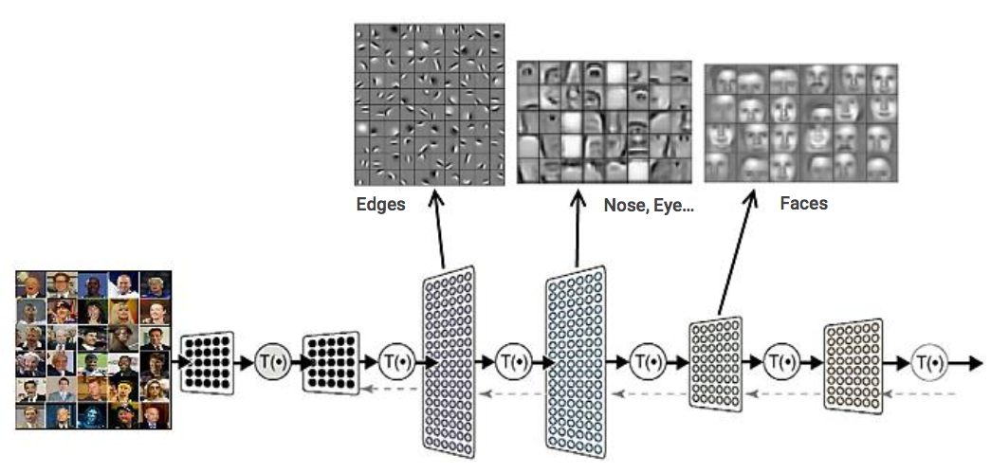
Facial Recognition
Hierarchy: Input layer Hidden Layers Output Layer

Slide 42
Automated Driving

Slide 43
How it works?
Each Layer detects a particular feature by scanning an image
Some layers pool features
Final layer classifies

Slide 44
Training a Neural Network
Notes:
Learns by generating an error signal that measures the difference between the predictions of the network and the desired values and then using this error signal to change the weights (or parameters) so that predictions get more accurate.

Slide 45
Requirements
Lots of labeled data of high quality
Measurable goals and cost function
Lots of computing power

Slide 46
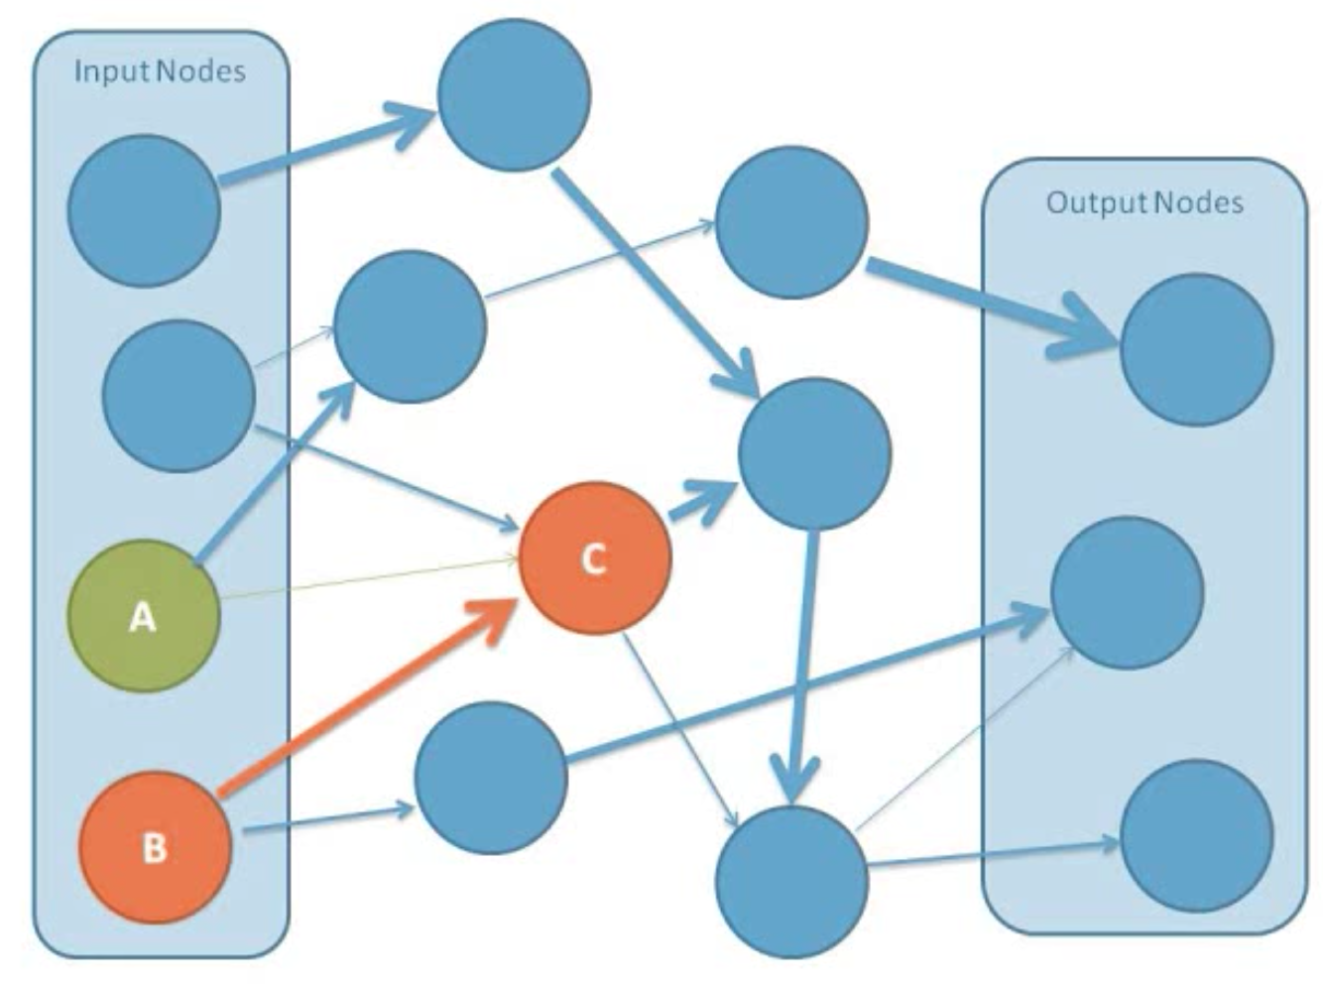
Connections have different weights
Notes:
Even though each neuron is connected to all the neurons in the layers before and after it, the weights make it so that only certain nodes have a significant effect.
From “Intro to Neural Networks” youtube video by Jesus Suarez
https://www.youtube.com/watch?v=DG5-UyRBQD4

Slide 47
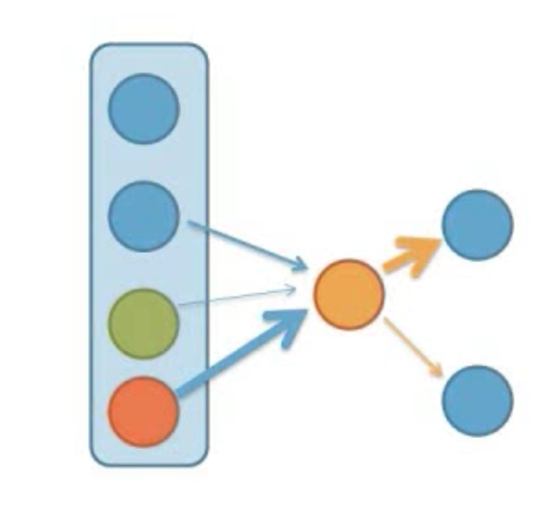
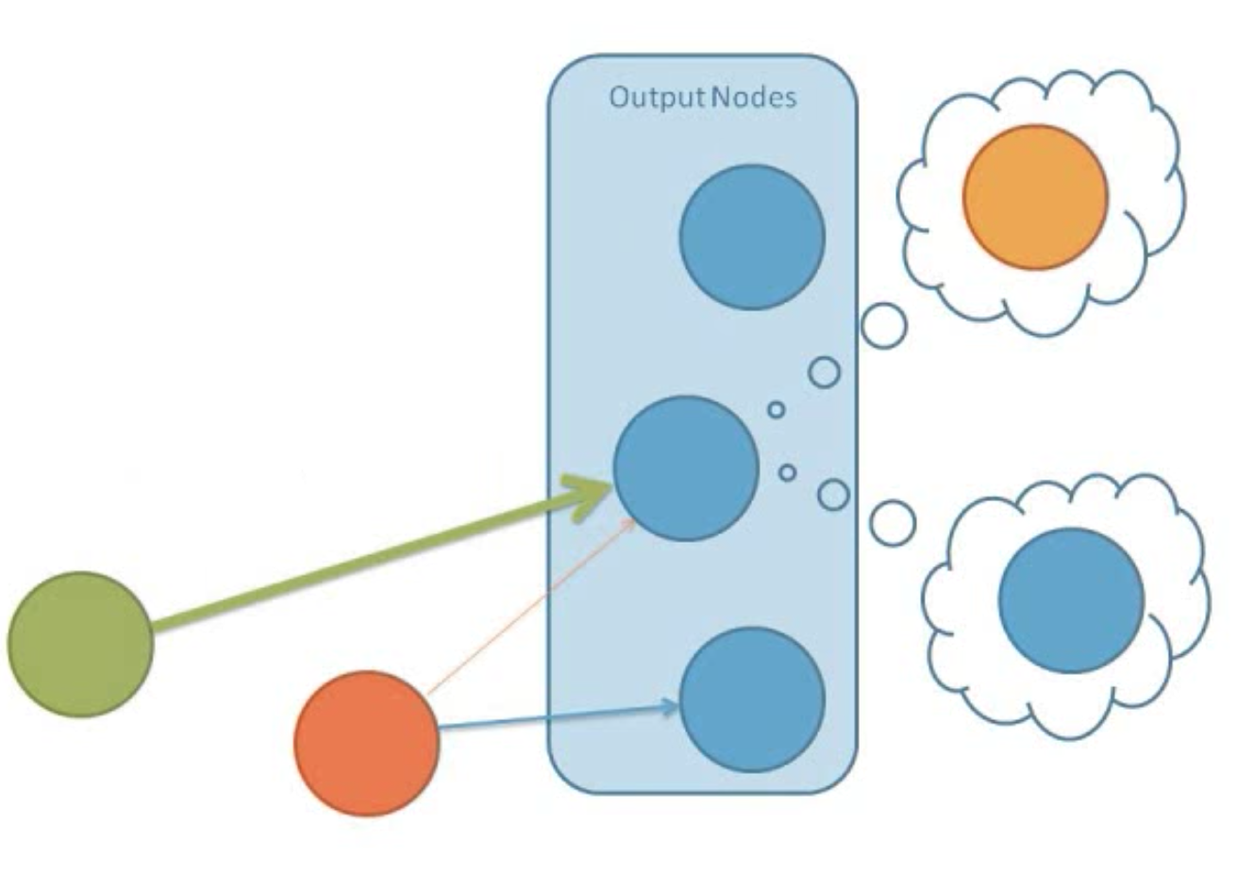
Node sets its value, triggers next node

Slide 48
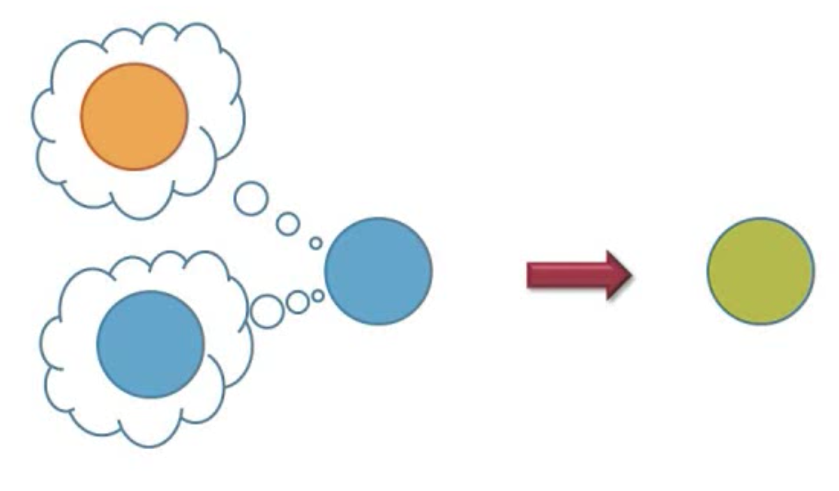
New value = old value + input

Slide 49
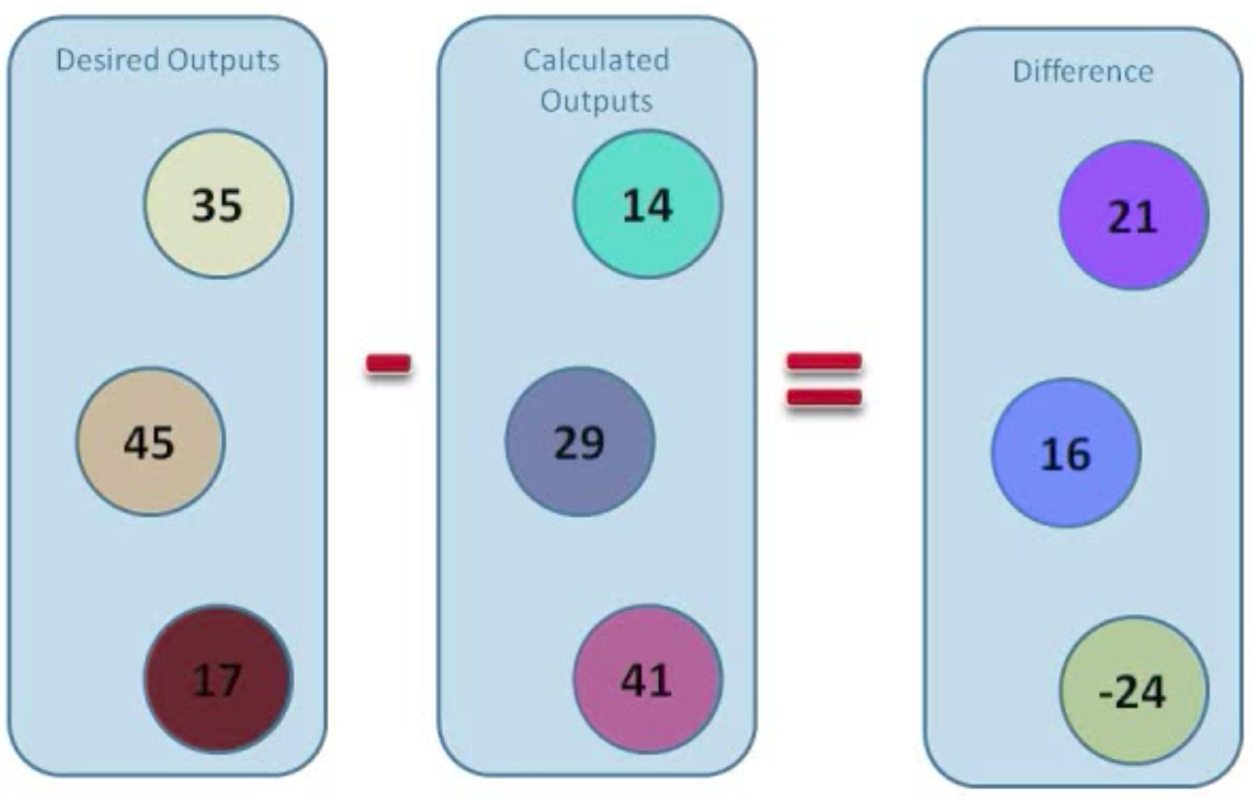
Error in the network

Slide 50
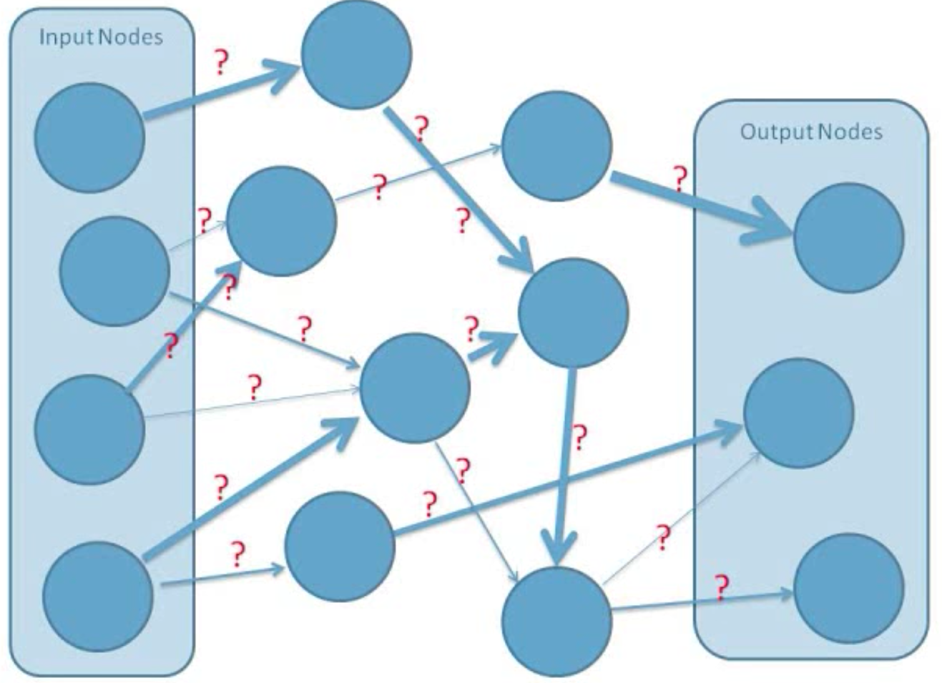
Backpropagation
The process to learn the correct weights starts with random weights

Slide 51

Gradient Descent
Find the minimum of the cost function
Use that to adjust the weights
Notes:
Gradient Descent finds the (local) the minimum of the cost function (used to calculate the output error) and is used to adjust the weights.

Slide 52
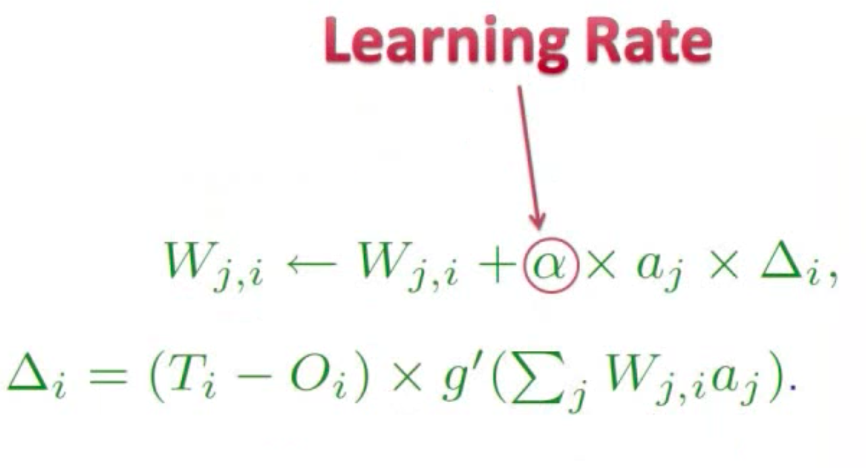
Learning Rate
Notes:
Each digit, each sample of digits

Slide 53
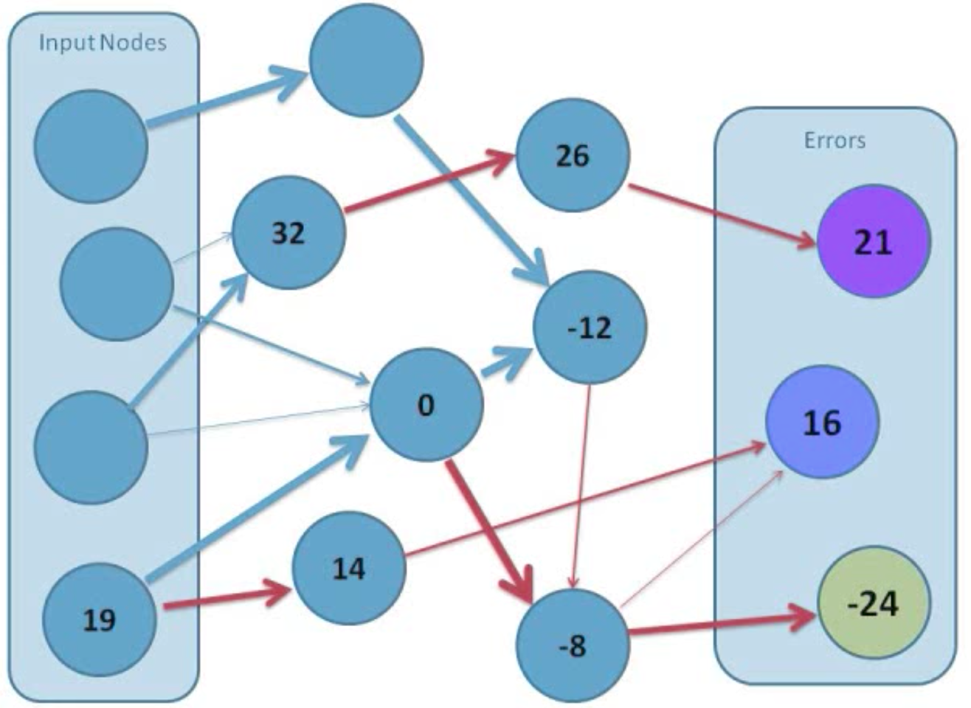
Backpropagation
Improved connection weights compared to the random ones

Slide 54
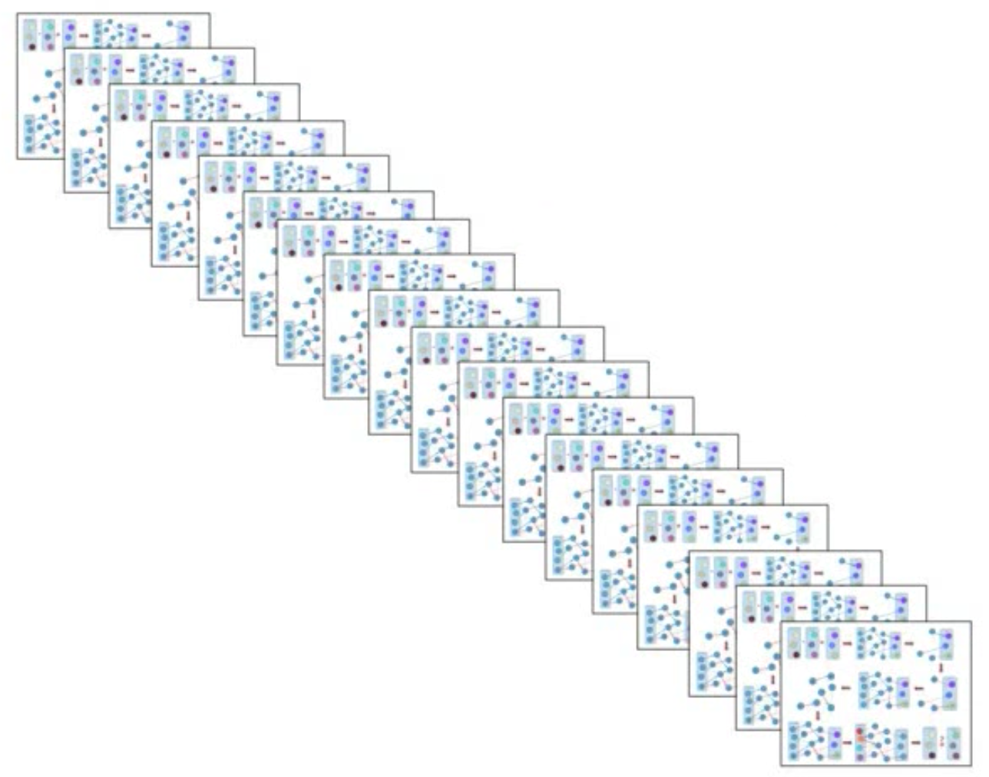
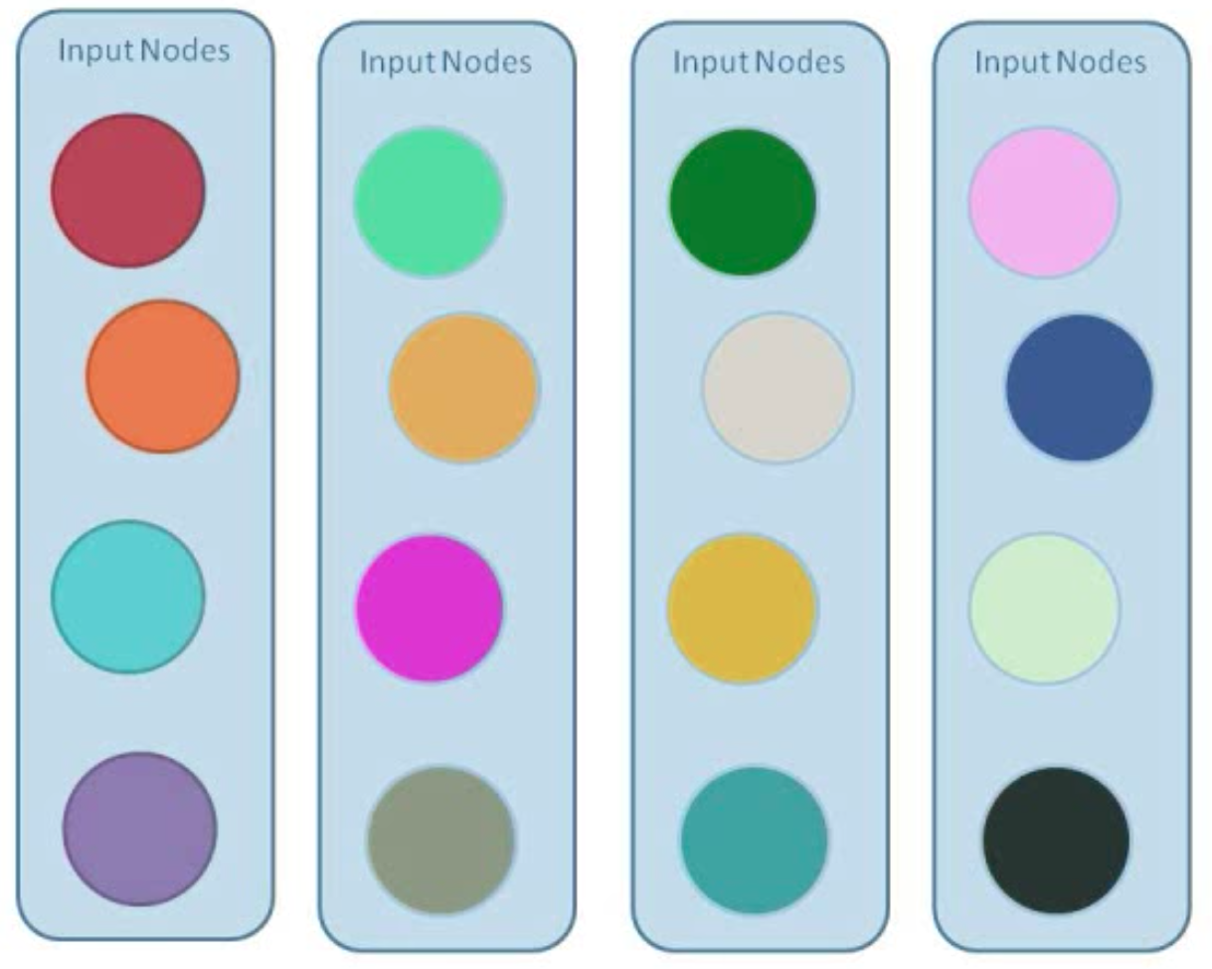
Repeated for each input set
Notes:
Each digit, each sample of digits

Slide 55
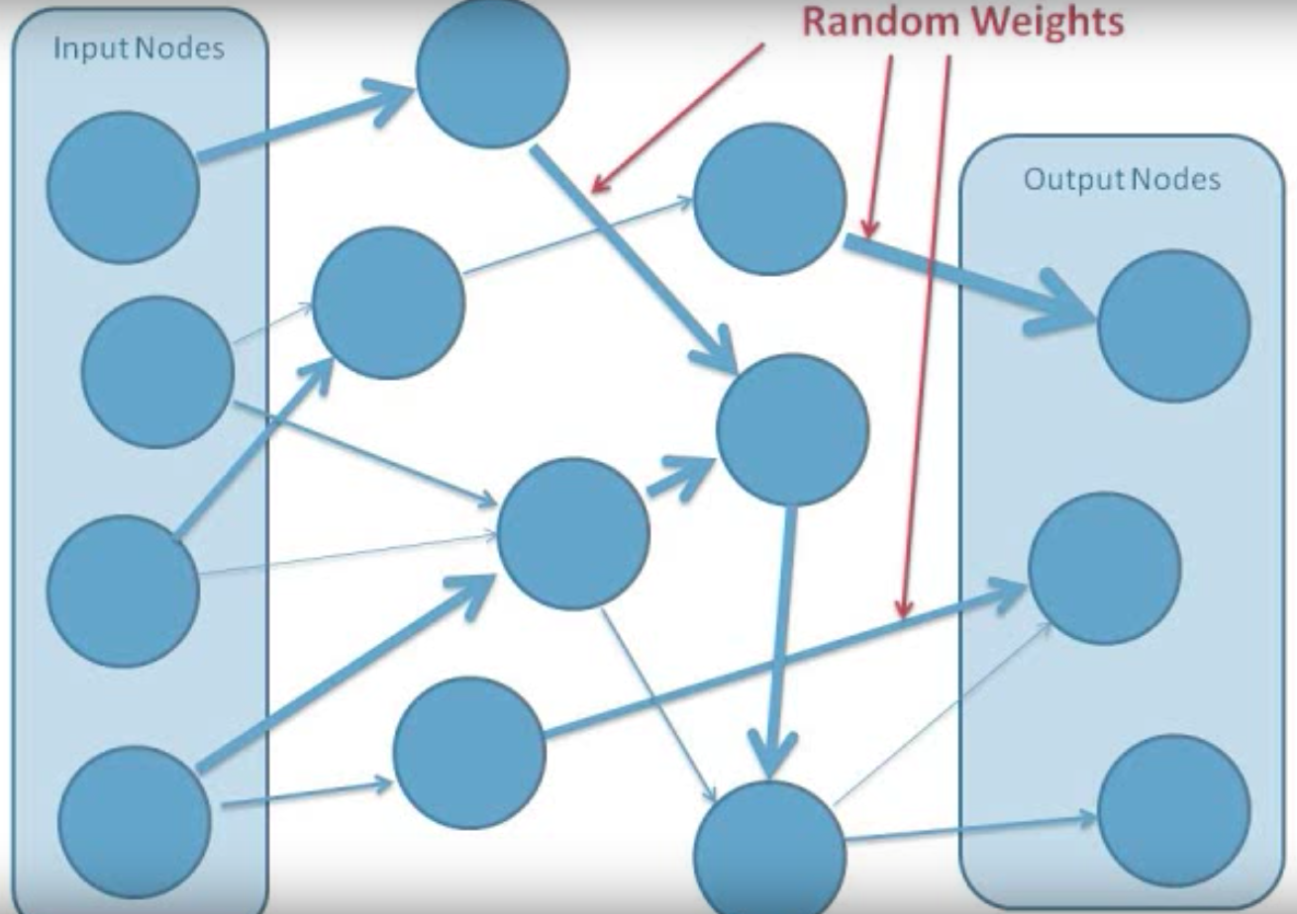
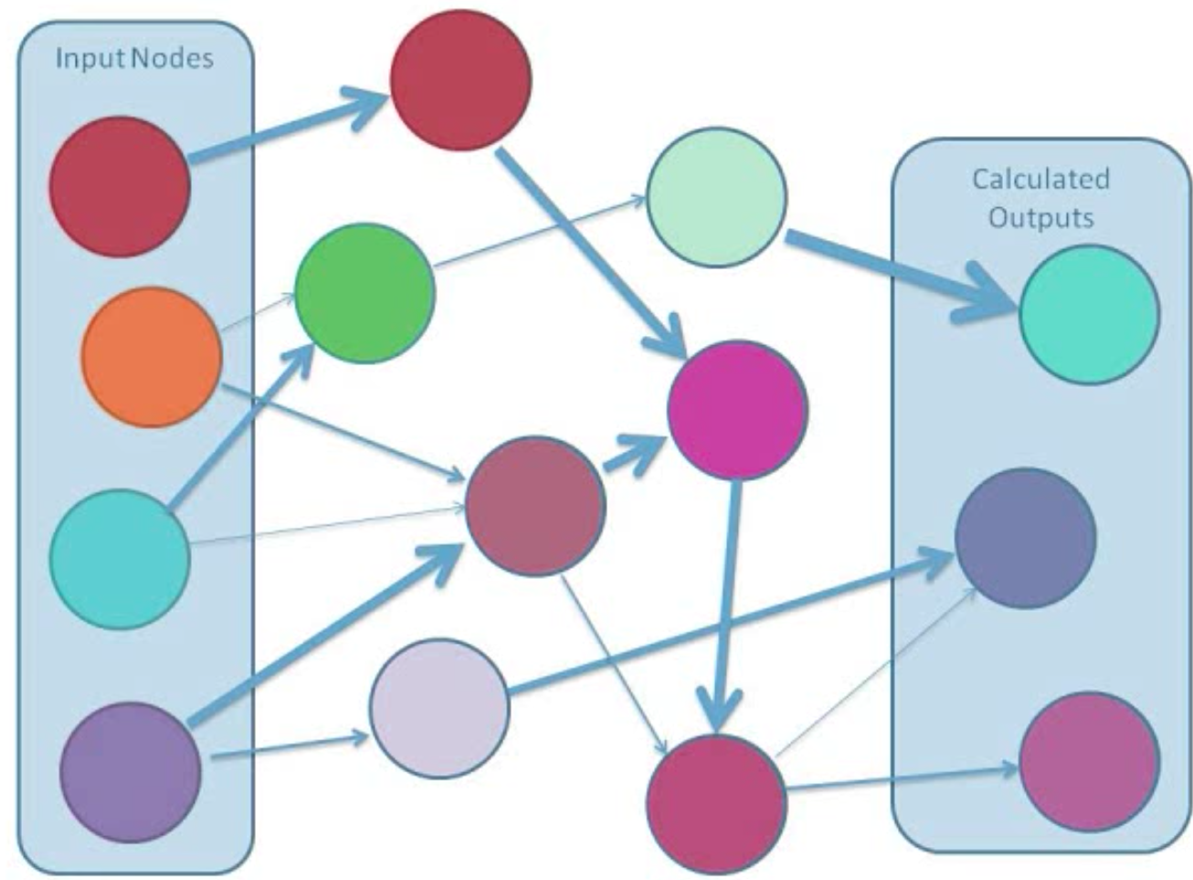
Determining connection weights
Notes:
Start giving connections random weights,
Give input and calculate outputs based on the random weights.

Slide 56
Neural Networks - Playground
Notes:
Start giving connections random weights,
Give input and calculate outputs based on the random weights.

Slide 57
Challenges
Training on less data
Natural Language Processing
Understanding videos
Deep reinforcement
Unsupervised learning
Quantum computing

Slide 58
Digit Classification Case
Lunch

Slide 59
Course Assignments
Programming Assignments
Reading Assignments
Presentation Assignments
Technical Skills Assignments
Writing Assignments

Slide 60
Technical Assignment
Install & Setup RStudio on AWS

Slide 61
Programming Assignment
Install & Complete: Swirl – Exploratory Data Analysis
Install & Complete: Swirl – Statistical Inference

Slide 62
Reading Assignment
Read Chapter 5: Resampling Methods

Slide 63
Writing Assignment
Submit by Saturday
Written Report (not to exceed 15 pages) on Mushroom Classification Case

Slide 64
Presentation Assignment
By Saturday Submit
Your Presentations on Mushroom Classification Case
Technical Presentation
Business Presentation (Not to exceed 5 slides)

Slide 65
Instructor Case – MNIST Digit Classification

Slide 66
Instructor Case - MNIST Digit Classification

Slide 67
Digit Classification Case
Demo Time

Slide 68
Digit Classification Case
Introduction to AWS

Slide 69
Summary
Neural Networks
Multi Layer Perceptron
Deep Neural Networks
Examples
Hidden layers
Backpropagation
Weights
Errors
Learning coefficients
Requirements
Gradient Descent

